Slide 1
Mindfulness with children
Caroline King
Assistant Educational Psychologist – Oxfordshire County Council
Notes:
Who am I?
What do I do?
Why am I here?
What have I been doing at St Andrews?

Slide 2
What is Mindfulness?
Mindfulness means becoming more aware of the present moment, with a sense of kindness and curiosity. This can help us enjoy the world around us more and understand ourselves better.
“The best way to capture moments is to pay attention. This is how we cultivate mindfulness. Mindfulness means being awake. It means knowing what you are doing.” – Jon Kabat Zinn
Notes:
There are lots of different definitions for mindfulness out there.
It includes noticing things inside ourselves (e.g. thoughts, feelings and physical sensations) and outside ourselves (e.g. feeling gratitude for the world around use).
Becoming aware of the present moment - including those happening inside ourselves (how we’re feeling, physical and outside of us which
https://www.youtube.com/watch?v=1msO9hn0iLU

Slide 3
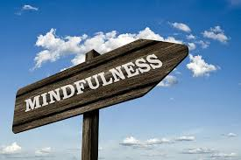
What does it mean to be mindful?
Mindfulness means becoming more aware of the present moment, with a sense of kindness and curiosity.
How do we achieve this day-to-day?
Notice the everyday
Keep it regular
Try something new
Watch your thoughts
Pause, notice, respond
Notes:
Day-to-day mindfulness:
Notice the everyday – pay attention to all the experiences during day-to-day life
Keep it regular – try and practice being mindful and paying attention
Try something new – changing things up can help you see the world in a new way
Watch your thoughts – its not about making them go away, but noticing that they happen
Name thoughts and feelings – when you experience difficult emotions, labelling them
Pause, notice, respond – instead of reacting to daily stressors
Mindfulness practice – sometimes called mindfulness meditation

Slide 4
Mindfulness Practice
Mindfulness practice is a formal exercise of mindfulness which involves:
Sitting silently with you eyes closed
Paying attention to thoughts, sounds, the sensations of breathing or parts of the body
Bringing your attention back whenever the mind starts to wander
Being kind to ourselves when things become difficult
This can be something you do naturally or you can follow a script. There are various scripts available online (e.g. YouTube or Spotify) to listen to.
Notes:
Give an example here of what it might look like – video of children doing some mindfulness practice?
https://www.youtube.com/watch?v=lGobuBXCHBM
This is just a period of time set aside each day to practice being mindful. Can be easy to see it as hippy dippy but put simply it is some time out of the stresses of the everyday (which even children experience) empty your mind of the worries of the day and notice and appreciate the present moment.

Slide 5
Where does it come from?
People have been practicing mindfulness for thousands of years, whether by itself or as part of a larger tradition e.g. Buddhism, Yoga
It was brought into Western society by Jon Kabat-Zin, who founded the Center for Mindfulness at the Massachusetts Medical School and developed a Mindfulness-Based Stress Reduction (MBSR) programme.
In the psychology world, mindfulness meditation has become a useful tool for anyone looking to increase their levels of well-being, and MBSR has also become popular in non-clinical populations including with children.
Notes:
It’s rooted in positive psychology – which is the idea that we spend a lot of time worrying about what is going wrong, and we forget to look at what is positive and what makes us happy – focusing on building well-being.

Slide 6
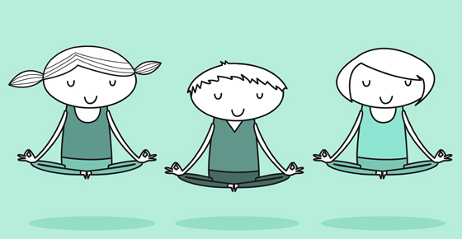
What can it help with?
There is evidence to suggest that practicing mindfulness can be effective in:
Improving wellbeing
Improving ability to think clearly
Improving mental, emotional, social and physical health
Improving sleep and self‐esteem
Bringing about greater calmness & relaxation
Improve self-regulation of behaviour and emotions
Improve self‐awareness and empathy.
Notes:
There is an NHS page on mindfulness sharing its benefits in physical pain management and emotional well-being. GP’s are referring adults to 8-week courses to reduce stress.
Not suggesting that’s something that children at school are experiencing depression/anxiety or mental/physical health issues experiencing but there are pressures in their own right of being a child, falling out with friends in the play ground, coming across a tricky challenge in the playground.. And practicing mindfulness and being able to re-focus, calm down and be more aware of ourselves and our thoughts gives children the tools to manage any potential challenges they are facing, or might face in the future more confidently
I think it’s easy to see mindfulness as a bit of a fad – something that’s popular right now but wealth of evidence behind it demonstrates its effectiveness in improving wellbeing.

Slide 7
What Does research say?
Meiklejohn and colleagues (2012) looked at 14 high quality studies investigating the effectiveness of teaching mindfulness to children and found improvements in:
Working memory
Attention
Academic skills
Emotional regulation
Self esteem
Self reported measures of mood
Self reported decreases in feelings of anxiety, stress and fatigue.
Notes:
Evidence is in it’s early stages but all results so far have been really promising. There’s a great TED Talk AnneMarie Rossi about mindfulness in schools.
Working memory – immediate processing of information
Other studies have found improvements in well being, reducing levels of aggression.

Slide 8
Mindfulness attention programme
I have been running the Mindfulness Attention Programme with Year 4
It is a 9 week whole class intervention which involves teaching children the basic principles of mindfulness including practicing mindfulness meditation.
Pupils learn how to take a break from day-to-day life in school to notice more of what goes on around them and enjoy the present.
This helps them be able to respond to events, instead of react automatically to them.
These simple skills can support improved attention and concentration in the class room.
The skills learnt in this programme can enable children to deal with the ups and downs of life more effectively
Notes:
The aim of the programme is to break-down the areas of mindfulness: noticing physical sensations, thoughts, focusing on breathing and talking about what this can help with.
School can feel a little bit of rush, children constantly thinking about what’s next etc. Helpful to take a break and appreciate the present moment.

Slide 9
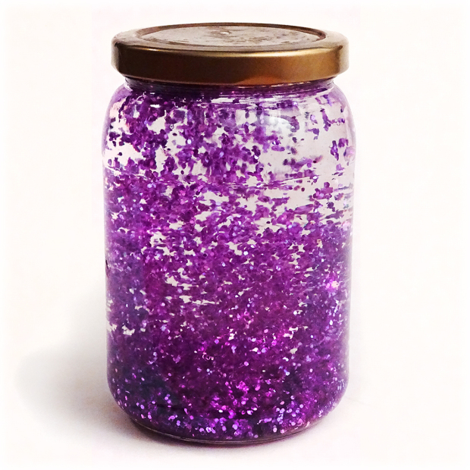
Mindful activities
Yoga poses – strong links to mindful practice can help children to notice sensations
Mindfulness meditation/practice & body scan – sitting in a quiet place and focusing on breathing, physical sensations and noticing thoughts
Mindful appreciation – noticing things within your day that usually go unappreciated – coming up with 5 things in that day
Mindful Jars – glitter jars that are shaken up as you watch the glitter settler, take a mindful moment
Mindful eating – Slowing down the experience of eating – breaking it down into difference senses – enjoying the moment!
Mindful walks – Paying attention to our surroundings whilst on a family walk!
Notes:
What can you do with your children
Yoga poses – have roots in meditation and can be relaxing and enjoyable for children
– Scripts are available on www.psychologyforchildren.com – they are often used to help children relax before bedtime
Mindfulness meditation –Body scan Could be done as a family – when I do MAP we do it as a whole class, not necessarily getting into any pose/for any long period of time but for you all just to take some time out and focus – practice makes perfect this can seem hard at first! https://www.youtube.com/watch?v=SEfs5TJZ6Nk
Mindful appreciation – mindfulness is all about appreciating and noticing the here and now – gratitude diaries are an extension of this
Mindful Jars – Glitter jars – fun to create (made from clear glue, glitter and hot water, food colouring) – a useful tool to practice using when your child is feeling cross or upset to help them feel calm

Slide 10
apps
Dreamy Kids – Guided meditation and daily inspirational quotes
Super Stretch Yoga – An app for introducing Yoga to children
Head Space – Mindfulness Meditation app – Tracks your progress, a good introduction to mindfulness
Stop. Think. Breath. (for children) – Mindful Meditation App & Emotional Check-In
*Smiling Minds – Mindfulness Mediation App, developed by Psychologists & Educators (free, non-profit)
Notes:
There are various apps you could you give a try – as with most apps there are in app purchases to make them better but the free parts give you a flavour of what they’re like.
Dreamy kids – child friendly
Super stretch yoga
Stop think breathe – in App purchases (subscriptions) (adult friendly version) – add different children (so they have their own area) introduces the idea of feelings by a check in – meditations are described as missions! - there are only 3 (have to pay to unlock more)
Smiling minds – No subscriptions – option to donate to non-profit (aimed at 7-18)
Headspace – subscriptions but the free version is good (daily meditations & basic guided scripts) - adult friendly
http://parentingchaos.com/anxiety-apps-kids/
Alternatively if you’re not interested in App’s there are lots and lots of mindful scripts and practices on YouTube – all free and readily available

Slide 11
websites
https://www.nhs.uk/conditions/stress-anxiety-depression/mindfulness/?
http://www.psychologyforchildren.com/
https://positivepsychologyprogram.com/mindfulness-for-children-kids-activities/
http://leftbrainbuddha.com/mindful-parenting-mindfulness-with-children
https://www.mindful.org/meditation/mindfulness-getting-started/
http://www.peacefulkids.com.au/meditations.html
Notes:
Positive Psychology Program – lots of activities (as discussed earlier)
Teach starter – classroom activities – could be adapted to home too!
Left brain buddha – has lots of great blog posts on teaching mindfulness to children – included a few links!
MAP website – the training programme includes scripts & body scans (quite long! But the man who developed the programme has a really calm & soothing voice!)

Slide 12
Any questions?
Notes:
I may not provide all the answers as I have only really had mindful practice in my life for about 6 months or so but I will do my best to answer your questions or find an answer for you! ☺

